Slide 1
Creating Mission Models using SysML and Cameo Systems Modeler
John DeHart -AVIAN Inc.

Slide 2

John DeHart
Hello, I’m John. I have worked in aerospace industry for +25yrs. I have been a part of several major aircraft development programs including 737-X, Cessna 650, B-2, F-22, and many missile programs including Tac-Tom, Javelin, JASSM, LRASM, NLOS, there are a lot more… I just forget. Most of my career has been in structures, controls, multidiscipline, simulation, and now as a systems engineer.
M.S. Systems Engineering, Georgia Tech B.S. MET, Georgia Southern
Outside of modeling and sim, I enjoy making home brew, and I have a neat greenhouse specializing in lettuce.

Slide 4
Creating Mission Models using SysML and Cameo Systems Modeler
John K. DeHart
jdehart@avian.com

Slide 5
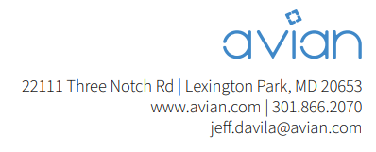
About AVIAN
Avian is a leading Service-Disabled, Veteran Owned Small Business (SDVOSB) with all the responsiveness and reachability of a small business and the resources of a large one (≈ 250 employees)
Our Capability
Provide skilled modelers at all levels of expertise Provide an initial “Assist Team” to assess capability needs Provide a functional environment with use of floating Cameo licenses Ability to produce modelers through organic training environment.
AVIAN’s Involvement in MBSE
Direct support to the NAVAIR / NAWCAD Systems Engineering Transformation (SET) team to build the processes and methodology necessary to implement MBSE at the organization level.
Direct support to SET for MBSE courseware development and training.

Slide 6
Introductions
Mission Modeling in SysML
What is the purpose of a model? → To Inform
Inform a document, simulation, analysis, etc.
Think of it like playing Risk..
Set the board up → play the game→ analyze your loss
Agenda
Some general modeling observations
Demo - Example mission laydown model
Demo - Example arrow
Wrap-up
Notes:
Today we are only setting the board up…

Slide 7
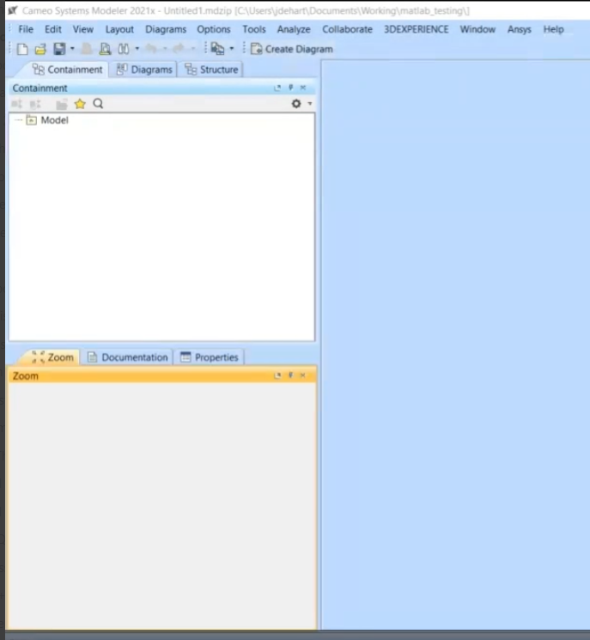
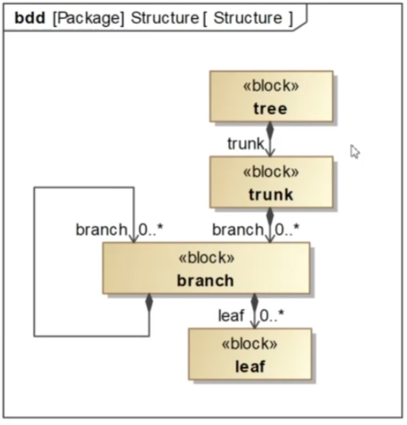
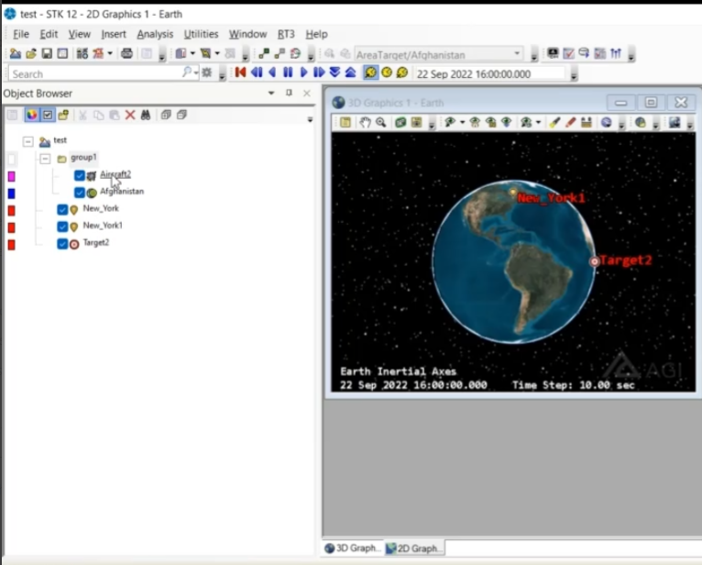
Containment Trees, Models, and Instances
This is where we make a model
This is where we make an instance
A model view
An Instance
Instance of
STK, Catia, etc
SysML
(it’s the white area)
Model
(it’s the white area)
When I start to build the mission model, I’m looking for a way to build this type of instance from the SysML model.
Notes:
- Explain that a SysML model is more than just diagrams.
Emphasize the importance of the containment tree, where diagrams are just views of the model.
I think a bit backwards sometimes when building a model… What does the model inform? Does it inform a simulation with an instance?

Slide 8
Defining Purpose, Objectives, Goals, and Scope
Before we start modeling, we need to define a clear purpose, objective, goals, and scope
What is the model informing? (a document, a sim, an analysis)
Do we need to inform structure? How does one do this?
How about Mission Critical parameters?
This is simply not an arrow
Systems model
Simulation
Analysis
?
?
Notes:
Need to be clear about what the model is doing. We don’t need all encompassing models. We can make smaller models and hook them together.
Arrows are difficult and often overlooked

Slide 9
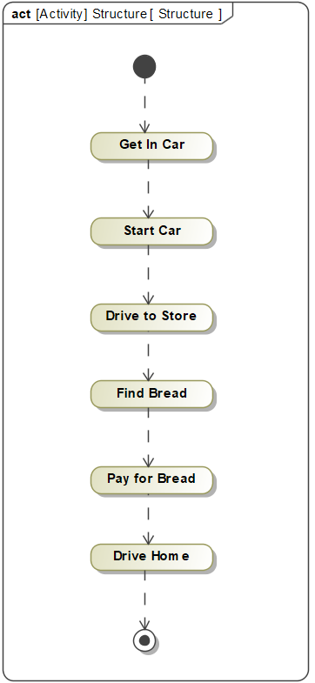
Creating Informed and Informing Models
Models should inform and be informed by other models to avoid creating malformed models
SE provides Mission Critical Information
What information does the simulation need?
Well All of it…
What does this model inform?
Simulation
Systems model
Analysis
Not just data, but data and form
Notes:
Models inform and are informed by the linking models
What does the SE model inform – Mission Critical Information
What information does the simulation need → All of it, the sim is stupid. I needs all of the information provided to run.
What should a model not look like. This may be a start of a model but how would you simulate this?

Slide 10
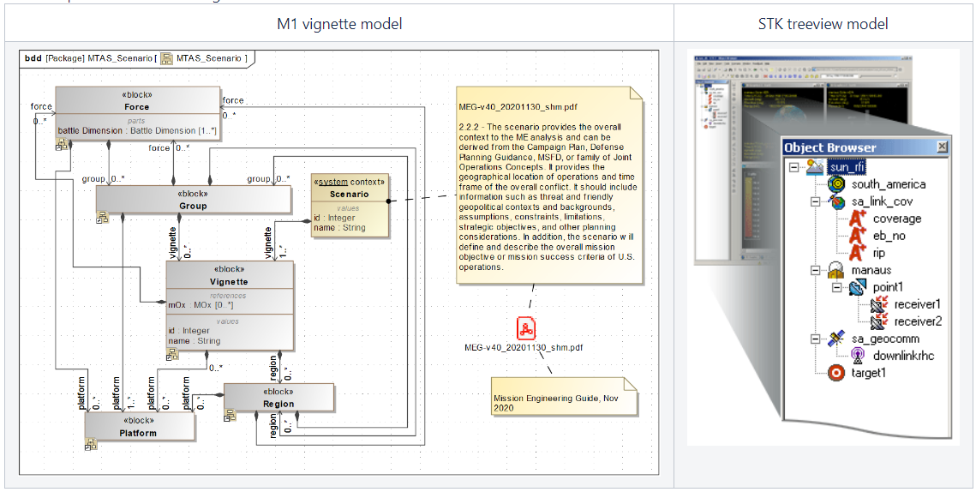
Treeview and Model Instances
In software development we have a Treeview
Typical for most engineering software
We can mimic this method when building systems models that inform
Particularly useful when informing the mission laydown
To inform, the systems model can simply take the form of a TreeView
Notes:
Back to the treeview one more time. Its important to understand that Im looking to make a treeview to move the model out to the rest of the world. Very good for laying down a mission.

Slide 11
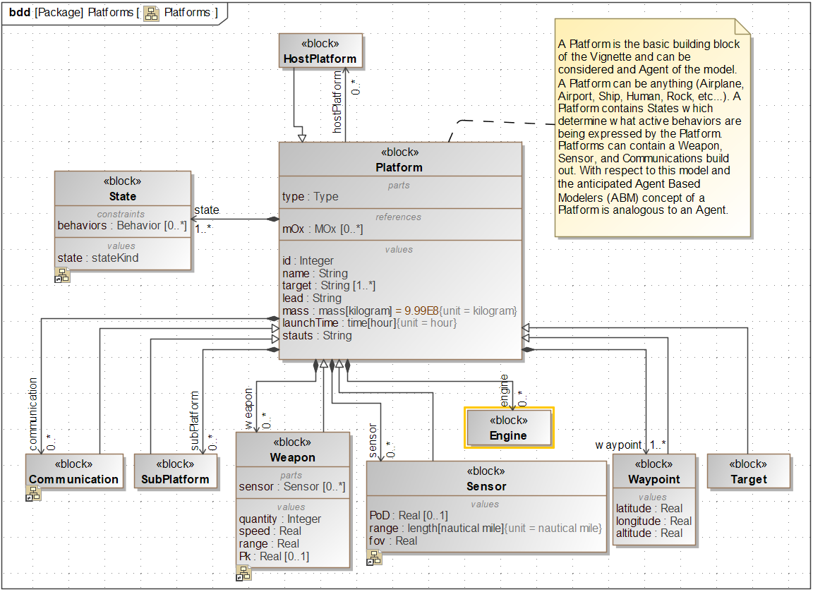
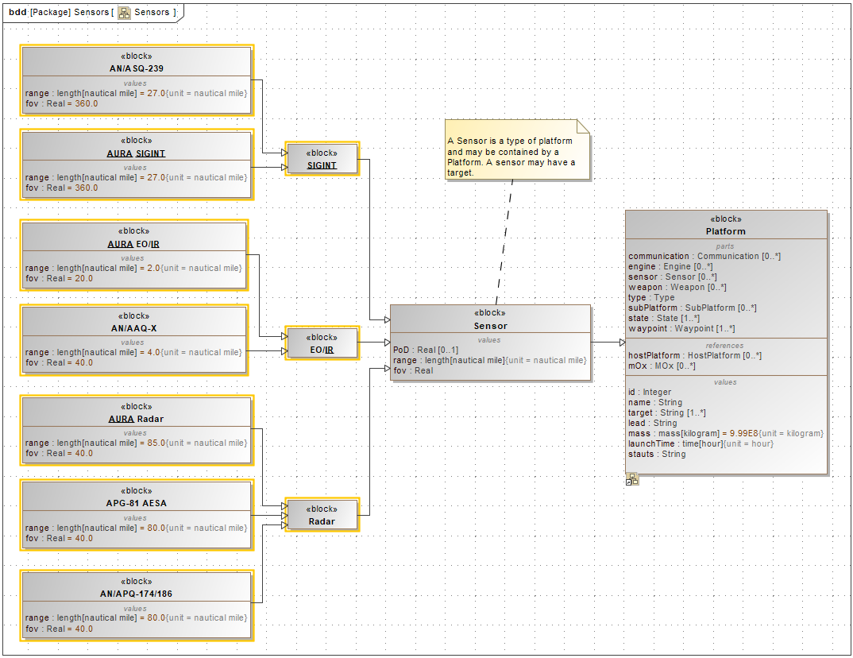
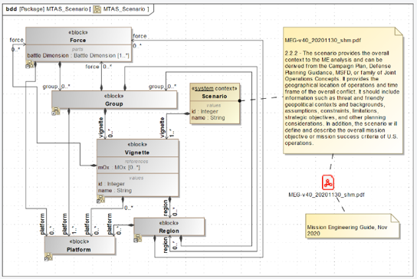
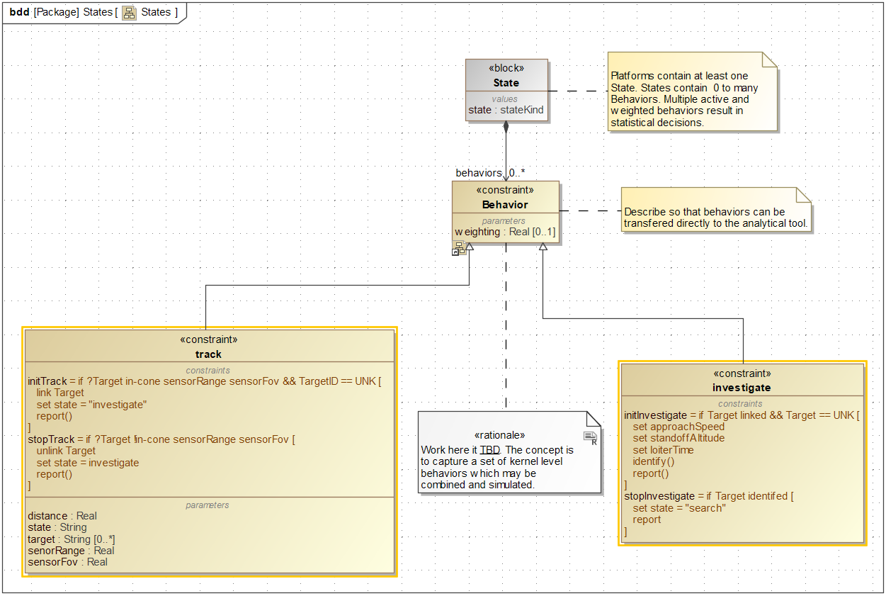
Thinking About Model Structure
Performer Config
Libraries
What structure do we need to model a mission? mission model, performer, behaviors, libraries…
If we are planning on simulating using an ABM what should the SE model look like?
Behaviors
Mission Config
Notes:
Just a summary here… what do we need for a mission model, mission config, behaviors, agents, libraries….

Slide 12
Demo - Building a Simple Mission Model
Demonstrate building a mission model
Use a remote medical support system as an example

Slide 13
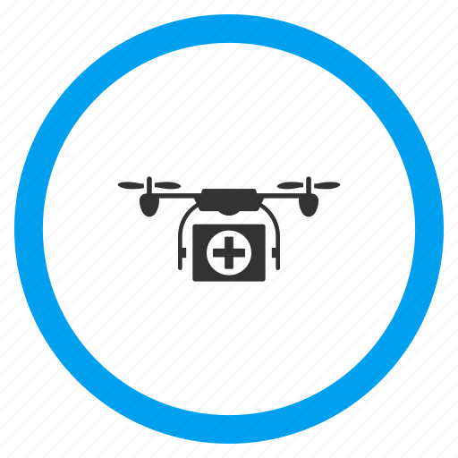



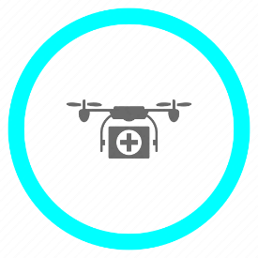



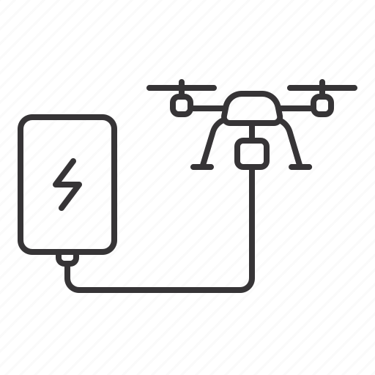
Rural Medical Support System (RMSS)
Rural Hospital requests medical support (medicine)
Request queue
Signals (Standard, Emergency)
FIFO queue (Standard)
Priority queue (Emergency)
Multi-size drone (light, medium, heavy)
Cargo capacity
Hospitals (LocX, LocY, rural, recharge)
Delivering Drone (Emergency)
Delivering Drone
(Standard)
Ready Drone
Rural Hospital
Emergency
City Hospital
Request Signal
Standard
Rural Hospital
Charging Station
Returning Drone
Return Signal
Notes:
This is fun… the slide just shows some simple system where rural hospitals can request medicine from a more stocked city hospital.

Slide 14
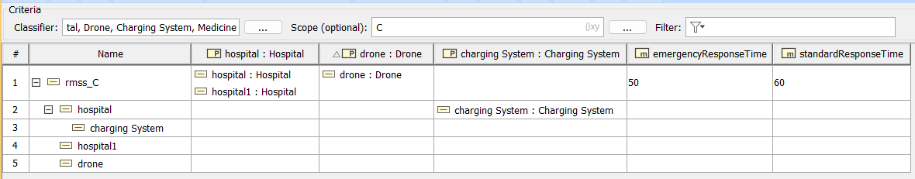
Demo - Creating Instance Tables
Demo creating instance tables for drones, hospitals, and medicine
Show to configure an instance table to behave as a treeview for building instances quickly
Notes:
Easy to recreate a treeview with a mission model and an instance table…

Slide 15
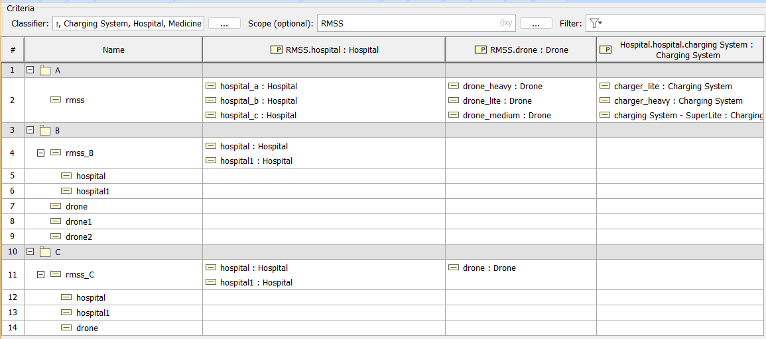
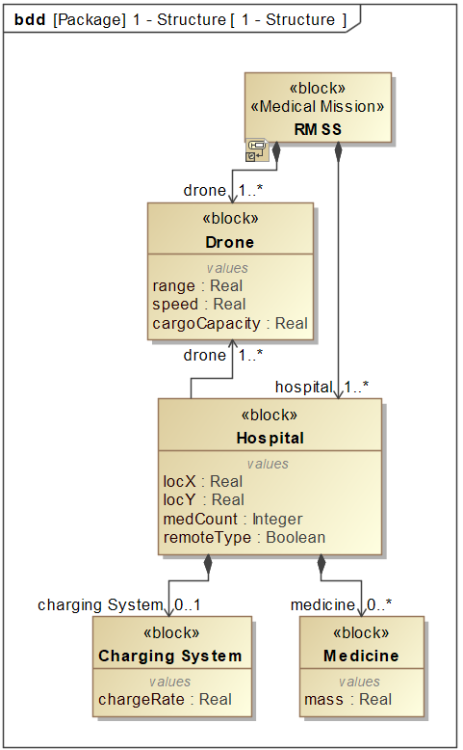
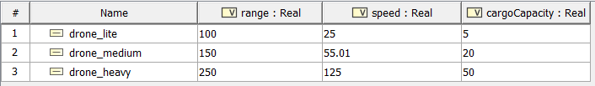
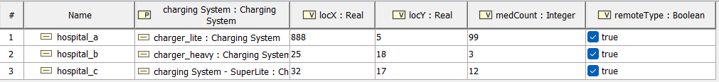
Demo - Mission Model Summary
Notes:
Summary of what we made in the demo…

Slide 16
Using Instances to Inform
There are different ways to export models
.mdzip: unzip and parse the xmi
XML: great for git repo and text-based versioning
API: perform CRUD operations on the model and access object
One big benefit of building skill with the API is that SysMLv2 is delivered with one right from the start potentially making transition easier
Add parts, delete parts, search the model, pull parameter sets, modify parameters, etc.
Using the API we can do almost anything that we can do in Cameo
Notes:
Couple of ways to do this, but the use of the API seems to fit in better with the automation aspects of MBSE and DE

Slide 17
Demo – Middleware (an Arrow) and API
Demonstrate accessing instances through the API and updating attributes
Discuss the flexibility and CRUD operations the API offers
All code here:
avianinc/2023-MBSE-Cyber-Experience-Symposium: Symposium materials and code (github.com)

Slide 18
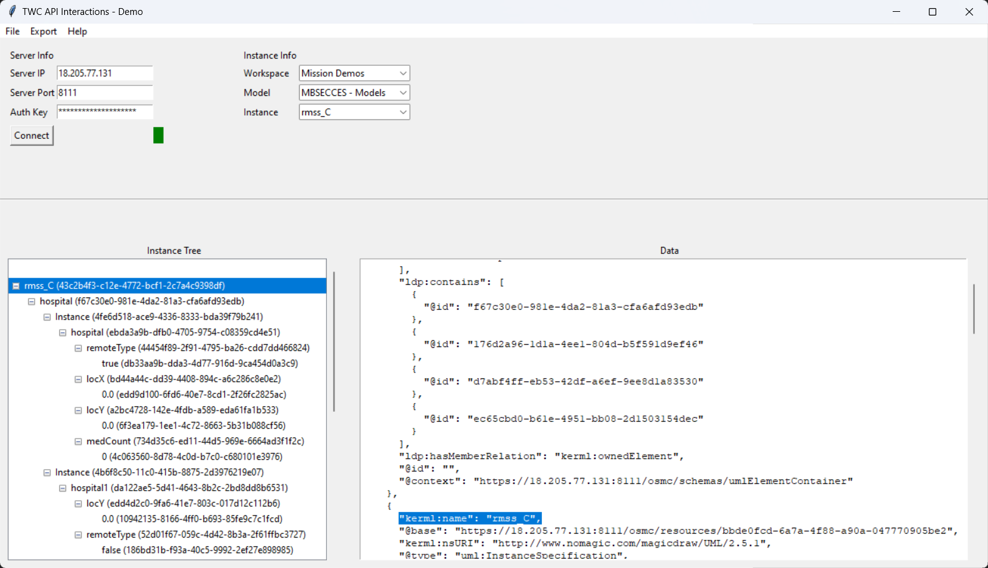
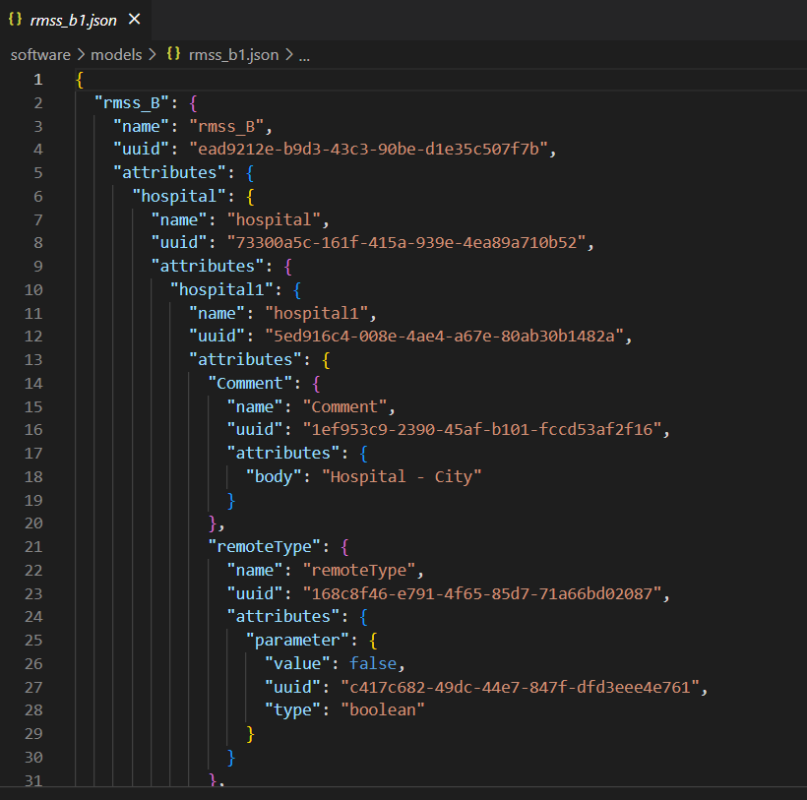
Demo - Simulation Integration
Export JSON file to demonstrate integration with Simulation
Show how updating the instance affects the simulation
This is an arrow ☺

Slide 19
Summary and Q&A
Have a clear understanding of what a model is going to be used for prior to stating to model.
Models inform and are informed by other models
It can help to think of a model as a treeview (instance)
The arrows are not easy, don’t forget the arrows
Using the API is very powerful and should be a major part of any project.
Questions? I open the floor for discussion… be gentle ☺

Slide 20
Thank you!
AVIAN Inc.
John DeHart (jdehart@avian.com)
Headquarters 301-866-2070 22111 Three Notch Road Lexington Park, MD 20653 | Panama City Beach 850-775-4904 1813 Thomas Drive Panama City Beach, FL 32408

